Slide 2
Setting the stage EEA Norway Grants 2014-2021 in Poland

Slide 3
Partnerships

Slide 4
Partnerships in numbers

Slide 5
Programmes in Poland under the EEA and Norway Grants
Communication in Polish media / Radio Nowy Świat
3 main areas: culture / history; green transition; security policy
CULTURE / HISTORY
Jewish Cultural Heritage: POLIN - Museum of the History of Polish Jews and Norwegian partners
GREEN TRANSITION
Carbon Capture and Storage (CCS) technologies: opportunities for Poland and Norway
SECURITY POLICY
NORPOLFACTOR: Polish–Norwegian Perceptions and Interactions
Estimated time of communication in media: December 2024 / January 2025
Form of communication: on-air interviews / content on demand
IT TAKES TWO TO TANGO 2024 – Poland

Slide 6
Security Policy
NORPOLFACTOR: Polish–Norwegian Perceptions and Interactions Report on security landscape. Publisher: Casimir Pulaski Foundation (PL) and Norwegian Institute of International Affairs (NOR). Published June 2024.
Pic.: screenshot, Casimir Pulaski Foundation, NUIP
IT TAKES TWO TO TANGO 2024 – Poland

Slide 7
Security Policy NORPOLFACTOR: Polish–Norwegian Perceptions and Interactions
One of deliverables of the NORPOLFACTOR project was a working paper, which maps mutual perceptions of Poland in Norway and Norway in Poland, and the basic ideas informing their approaches to security-related challenges caused by their location in Russia’s neighbourhood.
The aim of the project ”Norway and Poland as actors in a changing security landscape” (NorPolFactor) is to develop enhanced knowledge of the security-related challenges, risks and threats Poland and Norway face in their strategic environment in the aftermath of the Russian invasion of Ukraine in 2022.
IT TAKES TWO TO TANGO 2024 – Poland

Slide 8
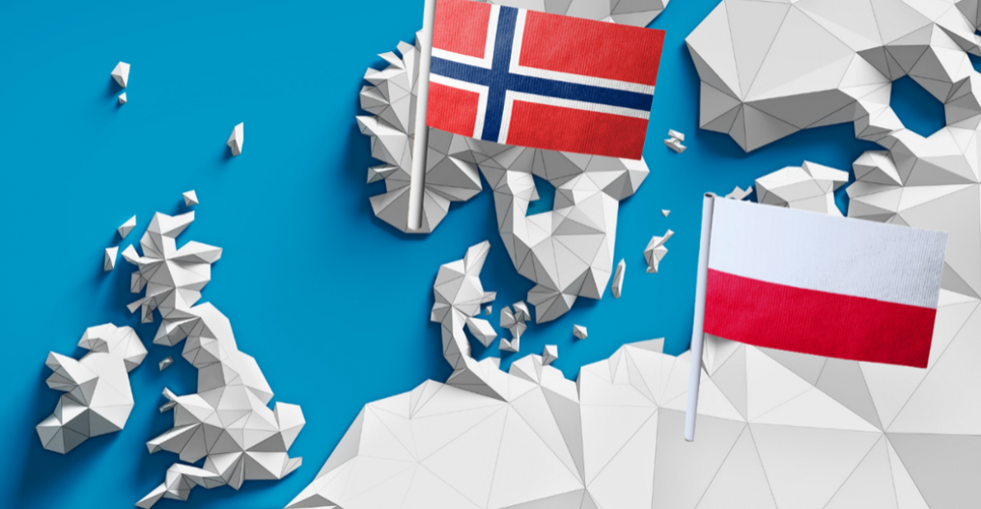
Green Transition
Carbon Capture and Storage (CCS) technologies: opportunities for Poland and Norway
Cooperation between AGH Univeristy of Science and Technology (PL) and University of Oslo (NOR). Meetings, networking events and workshops in Kraków, Poland, June 2024.
This venture served as a pivotal juncture for stakeholders from both nations to converge, fostering deeper ties and catalyzing transformative ventures in the realms of industry, innovations and academia.
Pic.: screenshot, Norwegian Energy Partners
IT TAKES TWO TO TANGO 2024 – Poland

Slide 9
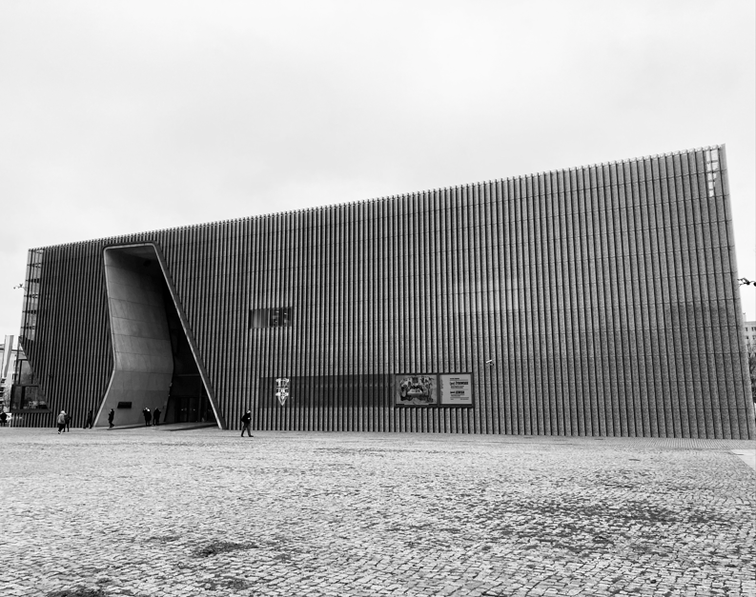
Culture / History
Jewish Cultural Heritage: Polin - Museum of the History of Polish Jews and Norwegian partners
The mission of the project was to ”recover the past and shape the future.” The project was based on a belief that getting to know the history of Polish Jews enhances the historical awareness of Poles, Jews and Europeans, for Jewish history is an integral part of the history of Poland, Europe, and the Jewish diaspora.
Photo: POLIN. Author's archives
IT TAKES TWO TO TANGO 2024 – Poland

Slide 10
Culture / History
Jewish Cultural Heritage: POLIN - Museum of the History of Polish Jews and Norwegian partners
Data:
Project promoter: Museum of the History of Polish Jews
Status: Completed
Final project cost: €9,804,962 (the EEA Grants by Iceland, Liechtenstein and Norway, and from Polish state budget)
The project was conducted in cooperation with:
European Wergeland Centre (NO);
Falstad Centre (NO);
Jewish Museum Oslo (NO);
Jewish Museum Trondheim (NO);
The Norwegian Center for Holocaust and Minority Studies (NO);
Jewish Historical Institute in Warsaw (PL).
According to Łucja Koch, project leader at POLIN, ”Jewish Cultural Heritage” made about 80% of the Museum's work in years 2020–2024.
IT TAKES TWO TO TANGO 2024 – Poland

Slide 11
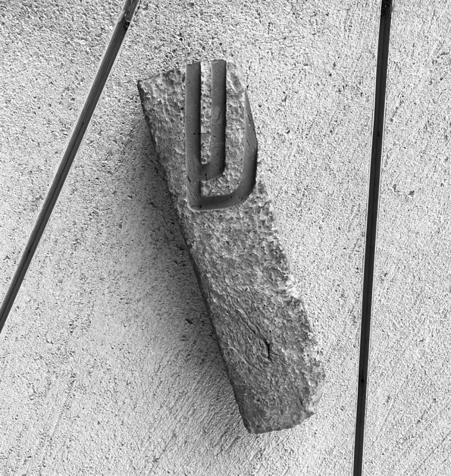
Culture / History
Jewish Cultural Heritage: POLIN - Museum of the History of Polish Jews and Norwegian partners
Main programmes: 1) programmes for teachers and students
”To listen to teachers in Poland and provide them with suitable tools, so that they can share the knowledge and the story of Polish Jews.” - Łucja Koch, project leader, POLIN Museum
According to Łucja Koch, EEA Grants made it posible for the Museum to start a series of online meetings for teachers and students during the lockdown.
Photo: POLIN, mezuzah. Author's archives
IT TAKES TWO TO TANGO 2024 – Poland

Slide 12
Culture / History
Jewish Cultural Heritage: POLIN - Museum of the History of Polish Jews and Norwegian partners
Main programmes: 2) ”Museum on wheels” travelling exhibition
Activities: 3 exhibitions: "Museum on wheels", "They risked their lives" and "They fill no space" and 473 events accompanying exhibitions (workshops, lectures, film screenings, concerts, Judaica exhibitions) organised together with local partners.
”'Museum on wheels' made it possible to reach smaller communities and provide an opportunity to discuss local history.” - Łucja Koch, project leader, POLIN Museum
IT TAKES TWO TO TANGO 2024 – Poland

Slide 13
Culture / History
Jewish Cultural Heritage: POLIN - Museum of the History of Polish Jews and Norwegian partners
Main programmes: 3) The ”Daffodils” social campaign
First edition: 2013; important social change: 15% more Poles belive that Ghetto Uprising was an important event in Polish history.
4) Crossing borders - building a network for cooperation
The goal of the programme was to establish an all-Polish and international network of cooperation and a platform for the exchange of experience for entities involved in the protection and popularisation of Jewish heritage and intercultural education in Poland, Norway and other European countries.
5) Websites: ”Virtual Shtetl” & ”Polish Rihteous”
IT TAKES TWO TO TANGO 2024 – Poland

Slide 14
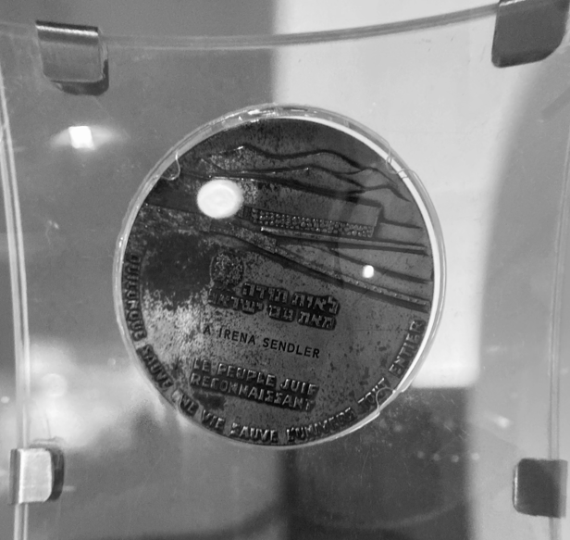
Culture / History
Jewish Cultural Heritage: POLIN - Museum of the History of Polish Jews and Norwegian partners
In 1965 Irena Sendler was recognised by the State of Israel as Righteous Among the Nations. She was a Polish nurse, who saved 2,500 Jews during Second World War. POLIN, Author's archives.
IT TAKES TWO TO TANGO 2024 – Poland

Slide 15
Culture / History
Jewish Cultural Heritage: POLIN - Museum of the History of Polish Jews and Norwegian partners
Project in numbers:
€9,804,962
grant from the EEA Grants by Iceland, Liechtenstein and Norway, and from Polish state budget
6,670,000
participants in Poland and in Norway
10,809
events
50
months
IT TAKES TWO TO TANGO 2024 – Poland

Slide 16
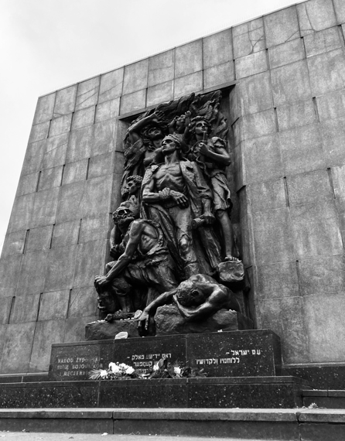
”We are not responsible for a past on which we had no influence. However, we are responsible for what we do about that past today.”
- prof. Dariusz Stola, Director of POLIN Museum of the History of Polish Jews (2014-2019)
The Monument to the Ghetto Heroes, Warsaw. Author's archives.
IT TAKES TWO TO TANGO 2024 – Poland

Slide 19
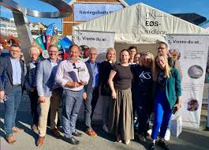
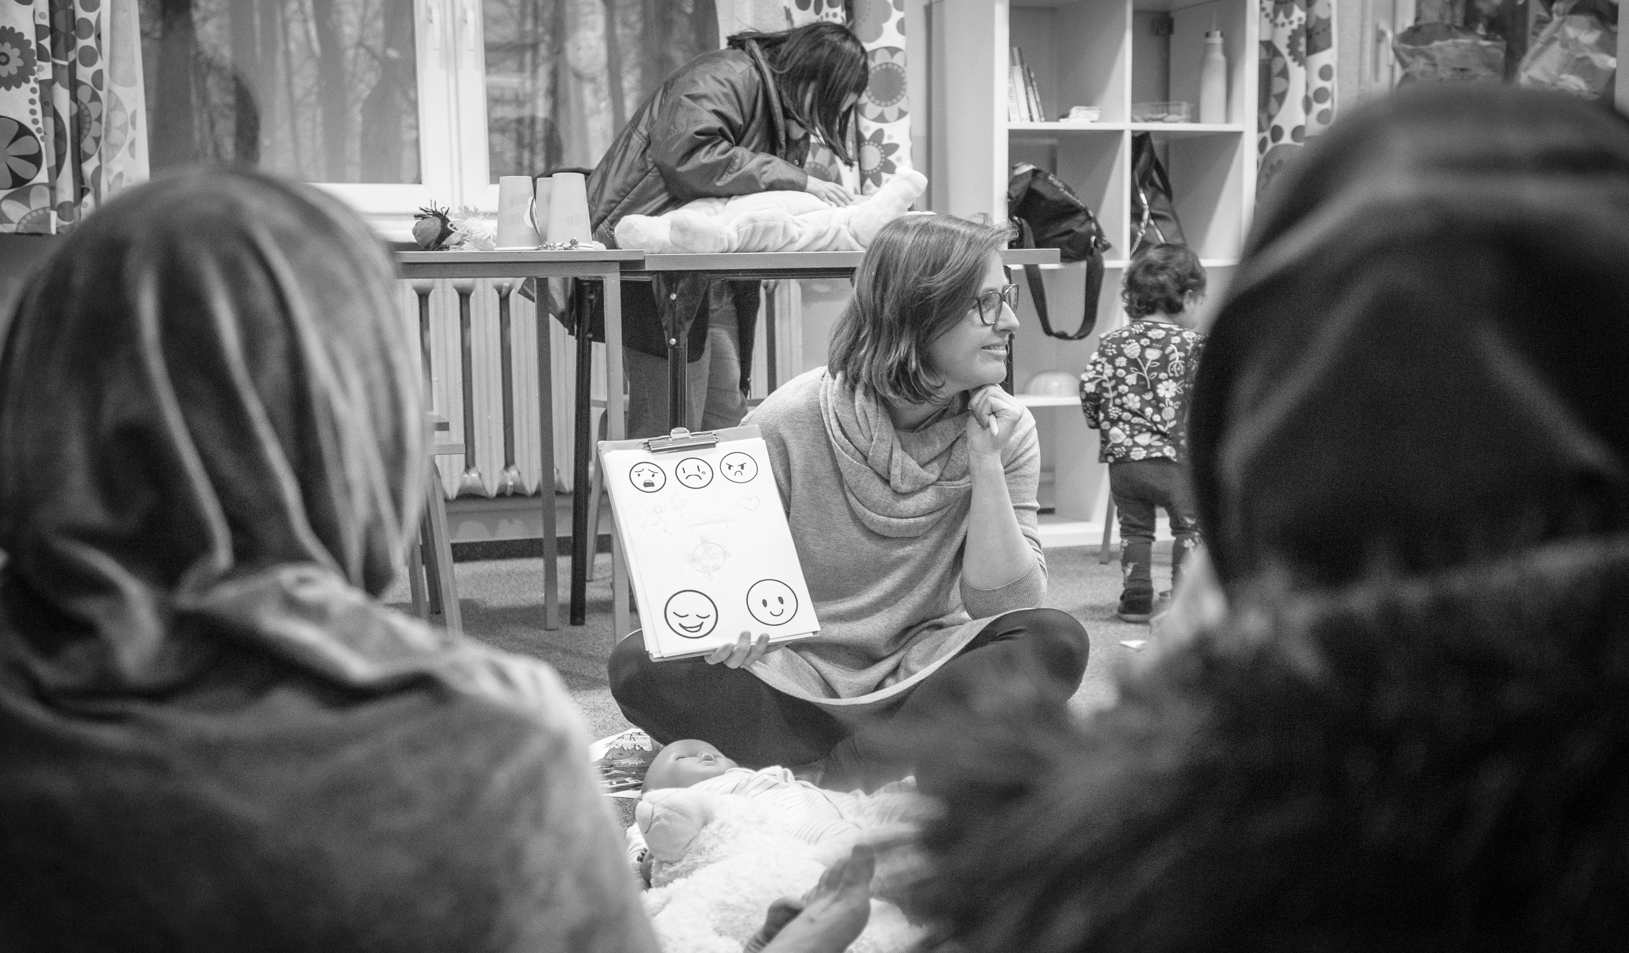
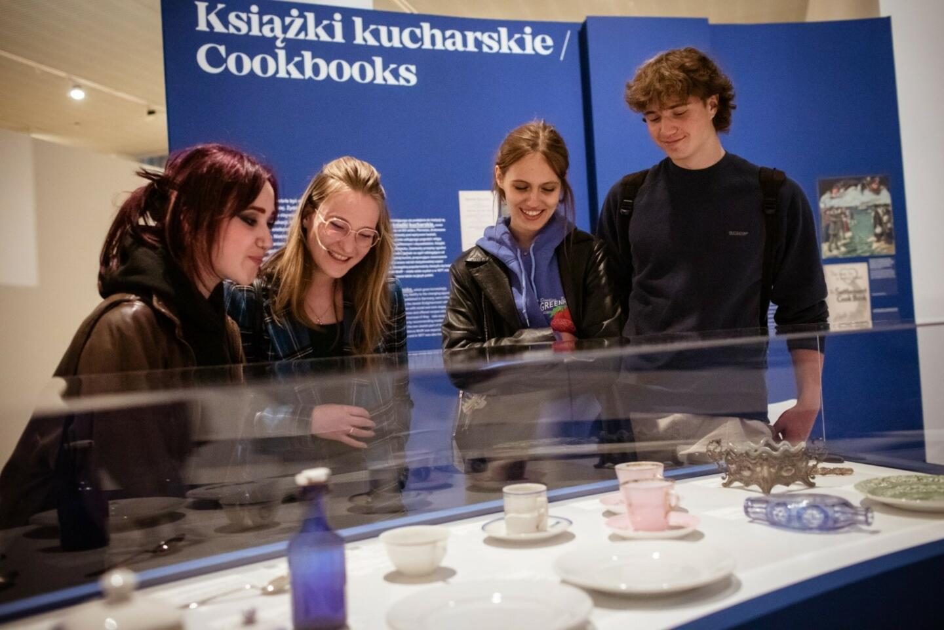
Human Factor
Openness
Respect
Honesty
Exchange
Positive energy
New approaches
Shared common values
Share experiences
Trust

